Slide 1
Digital Image Processing Topic:- Convolution and Correlation Process

Slide 2
Roll no: | Name:
KFPMSCCS005 | CALVIN
KFPMSCCS006 | DURVESH
KFPMSCCS007 | GANESH
KFPMSCCS008 | HANIF

Slide 3
Correlation in Image Processing:
Digital image processing is the use of a digital computer to process digital images through an algorithm.
Correlation/Convolution both are Common Linear Operations which involve: (addition, subtraction, multiplication and division).
It is the process of moving a filter mask over the original image and computing the sum of products at each location.
We use correlation to check similarity between two images.

Slide 4
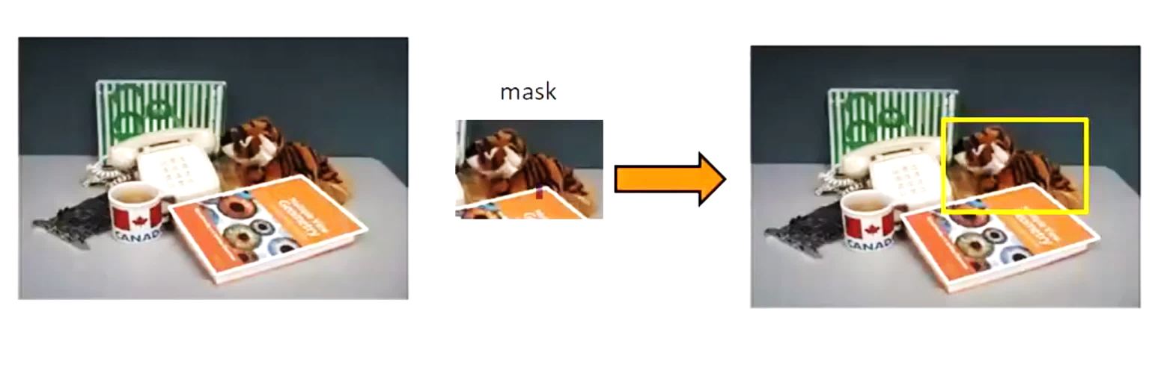
Correlation in Template matching:
Original image
Mask matching(overlapping) the original image

Slide 5
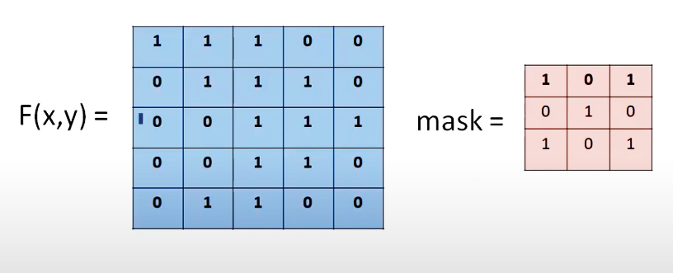
Example:
The Mask
The Original Image

Slide 6
Correlation Working and Features:
The filter mask is moved over the image from the top-left pixel of the image to the bottom-right pixel.
Then the sum of product of the mask and the original image is obtained
This process is done throughout the entire image to check the different degree of values obtained throughout the image.
The place where the highest value is obtained indicates that the mask is similar to the original image or the closest thing to it.
Correlation is mainly used for similarity measurement between two signals, signal comparison, template matching, pattern and relationship recognition, data analysis, etc.

Slide 7
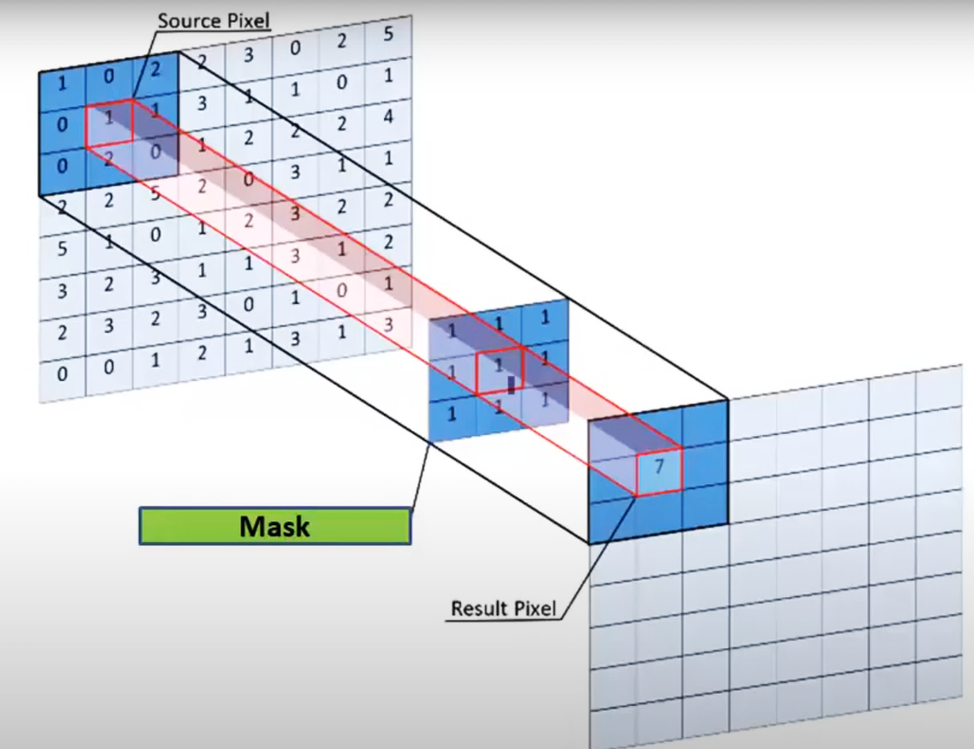
Original image with pixel values
Correlation:
(1x1)+(0x1)+(2x1)+(0x1)+(1x1)+
(1x1)+(0x1)+(2x1)+(0x1)
= 7

Slide 8
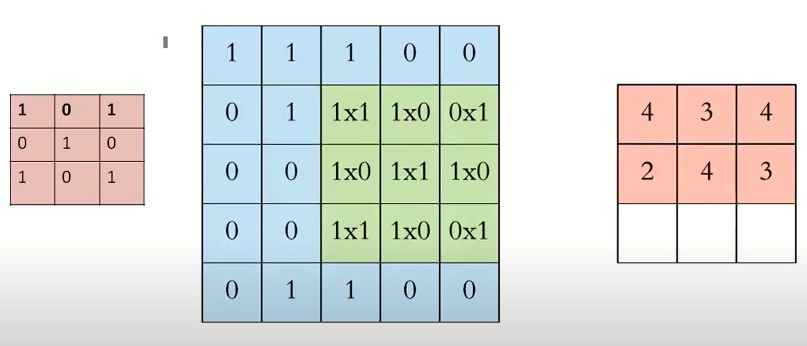
Getting the sum of product through Correlation:

Slide 9
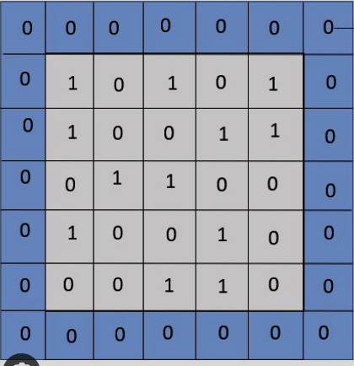
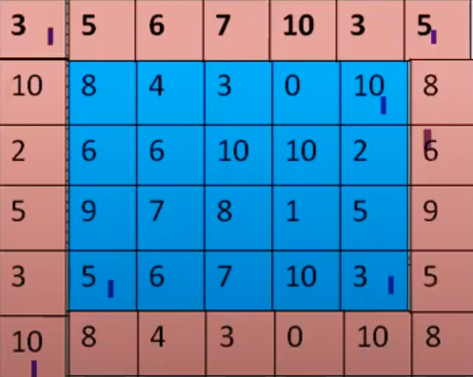
There are two types of padding techniques for a digital image:
1. The padding of the Border with zeros.
2. The padding of the Border with Wrap around method.
Zeros Padding
Wrap Around Padding

Slide 10
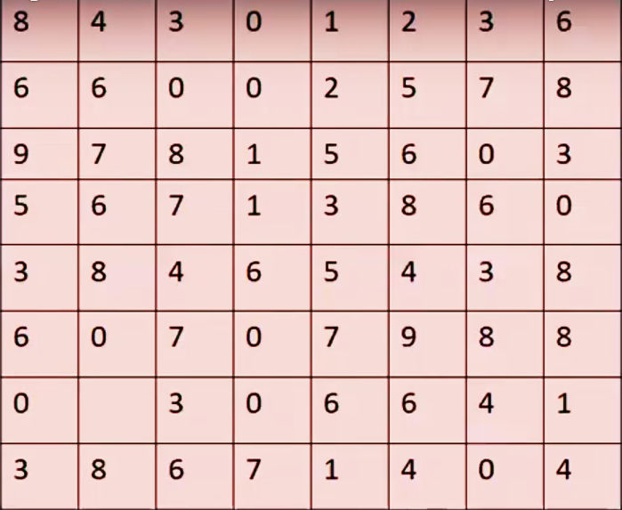
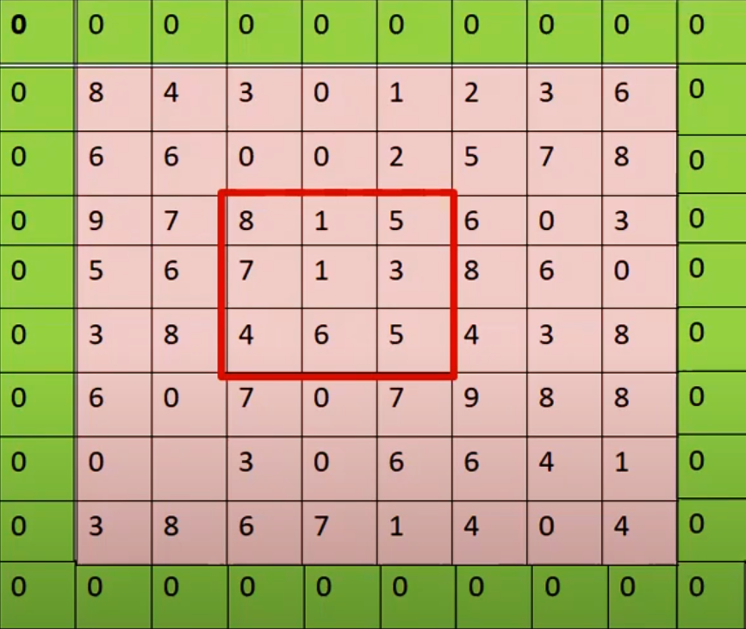
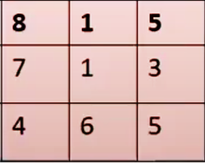
Original Image
Use of Correlation for template matching
Mask
Correlation:
(8x8)+(1x1)+(5x5)+(7x7)+(1x1)+(3x3)
+(4x4)+(6x6)+(5x5)
= 226

Slide 11
Convolution:
Convolution is similar to Correlation except that the Mask is Flipped both Horizontally and Vertically.
For symmetric matrix for mask i.e.
h(i, j) = h(-i, -j) convolution is equivalent to correlation.
h * f = f * h
Mask
Matrix Flipped Horizontally
Matrix Flipped Vertically

Slide 12
Convolution Working and Applications:
Flip the mask and do correlation.
The 1D mask is flipped horizontally, as there is a single row.
The 2D mask is flipped vertically and horizontally.
Mask is slid over the image matrix from the left to the right direction.
When the mask hovers on the image, corresponding elements of mask and image are multiplied and the products are added.
This process repeats for all the pixels of the image.
Convolution is widely used in the field of digital image processing, computer vision, data science, signal transformation, and more.

Slide 13
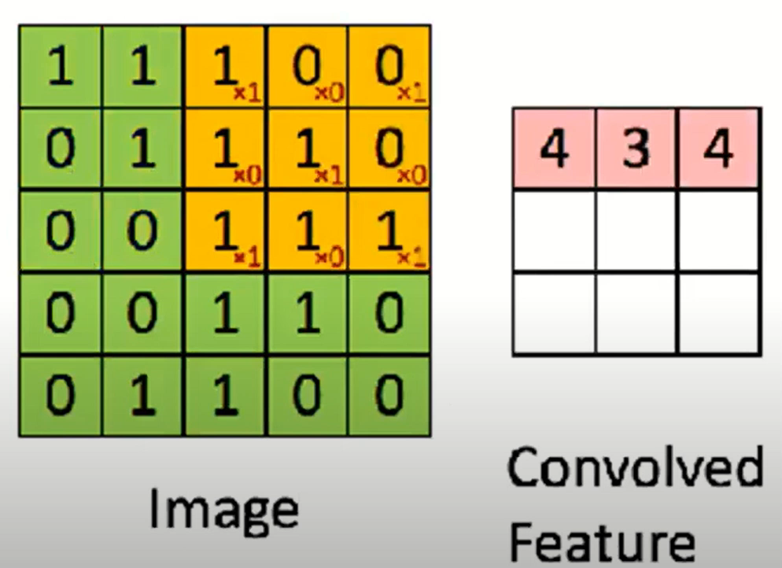
Convolution Process with the inverted mask:

Slide 14
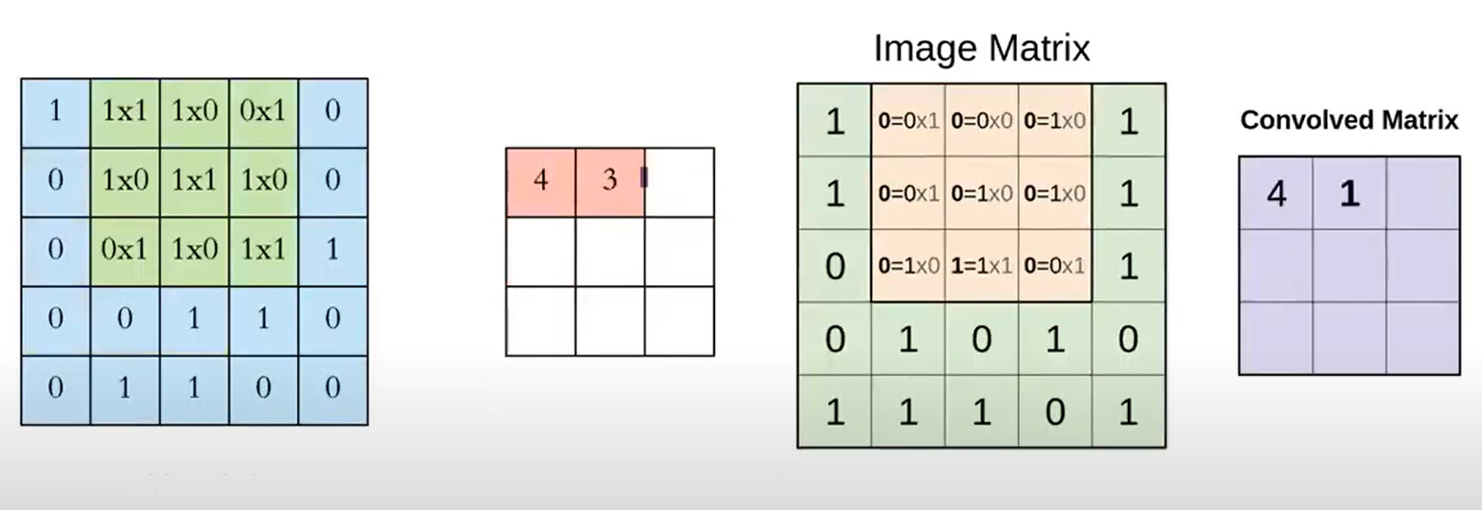
Correlation and Convolution Examples:

Slide 15
Difference Between Convolution and Correlation:
Parameter | Convolution | Correlation
Definition | Convolution is a mathematical operation used to combine two signals or function to produce a third signal or function. | Correlation is a mathematical operation used to measure or quantify the similarities and relationship between two signals.
MATLAB function used | Convolution is performed by using the 'conv ()' function in MATLAB. | Correlation is calculated by using the 'xcorr' function in MATLAB.
Purpose of operation | The primary purpose of convolution is to perform tasks, such as signal transformation and modification. | The main purpose of correlation is to quantify the similarities between two functions.
Output | The output of convolution of two functions or signals is a new function or signal which is a combination of input functions or signals. | The output of correlation is a value that represents the degree of similarity between two functions or signals.
Range of output value | In the case of convolution, the range of value of output depends on the input signals or functions. | The range of value of output of correlation is between -1 and 1. If the output of correlation is -1, it indicates a perfect negative correlation, if it 1, the correlation is perfect positive correlation, and if it is 0, there is no correlation between functions.

Slide 16
Parameter | Convolution | Correlation
Symmetry preservation | Convolution preserves the symmetry. | Correlation does not preserve symmetry.
Suitable for template matching | Convolution cannot be used to match template of the signals due to its symmetry preservation property. | Correlation can be used for template matching.
Applications | Convolution is widely used in the field of digital image processing, computer vision, data science, signal transformation, and more. | Correlation is mainly used for similarity measurement between two signals, signal comparison, template matching, pattern and relationship recognition, data analysis, etc.

Slide 17
Conclusion:
Both convolution and correlation are significant mathematical operations play a vital role in the various fields, such as data analysis, digital signal processing, pattern recognition, etc.
We can perform convolution and correlation of two function by using MATLAB.
In MATLAB, there are two built-in functions namely, 'conv' and 'xcorr' used to calculate convolution and correlation respectively.
The most significant difference between convolution and correlation is that the convolution combines two input signals and produces a third signal as output, while the correlation measures the similarity between two input signals.

Slide 18
THANK YOU

